Slide 1
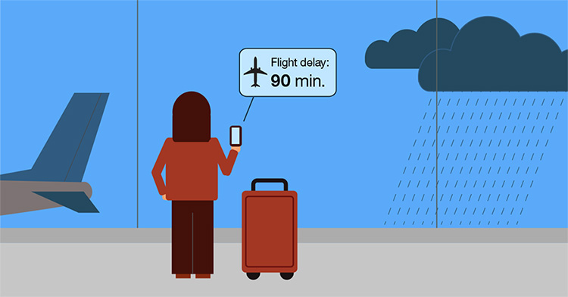

Secrets of Avoiding Flight Delays at NYC
Group 18
October 25, 2019

Slide 2
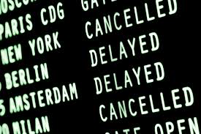
Can we help passengers in NYC area to avoid flight delays with data analytics?
1. Overview of NYC Airports - EWR, JFK and LGA
2. Delay Patterns in Time
3. Weather Condition Analysis
4. Airline Analysis

Slide 3




Team Members
Sinem Uysal
Mengya (Mia) Hu
Sonal Savaliya
Jianing Lu
PhD student in Operations Research and Financial Engineering at Princeton University
PhD student in Mechanical & Aerospace Engineering at Princeton University
MS Computer Science, Pace University
PhD student in Computational Chemistry at New York University
Notes:
The same order as the talk?

Slide 4
Overview of NYC Airports
Passenger traffic and flight records in 2017
Frequency of delayed flights in departures and arrivals
Breakdown of delay reasons
Sinem

Slide 5
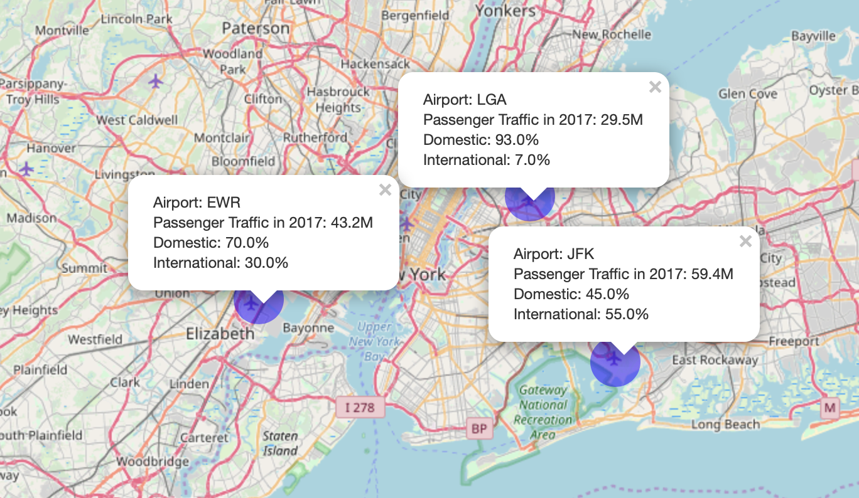
3 Major Airports in NYC Area - EWR, JFK and LGA
Dataset: Delays for US domestic flights in 2017 from Bureau of Transportation Statistics
Domestic flights in 2017
EWR ~ 23.4K
JFK ~ 18.9K
LGA ~ 18.6K
Passenger traffic at each airport is from Airport Traffic Report of The Port Authority of NY & NJ

Slide 6
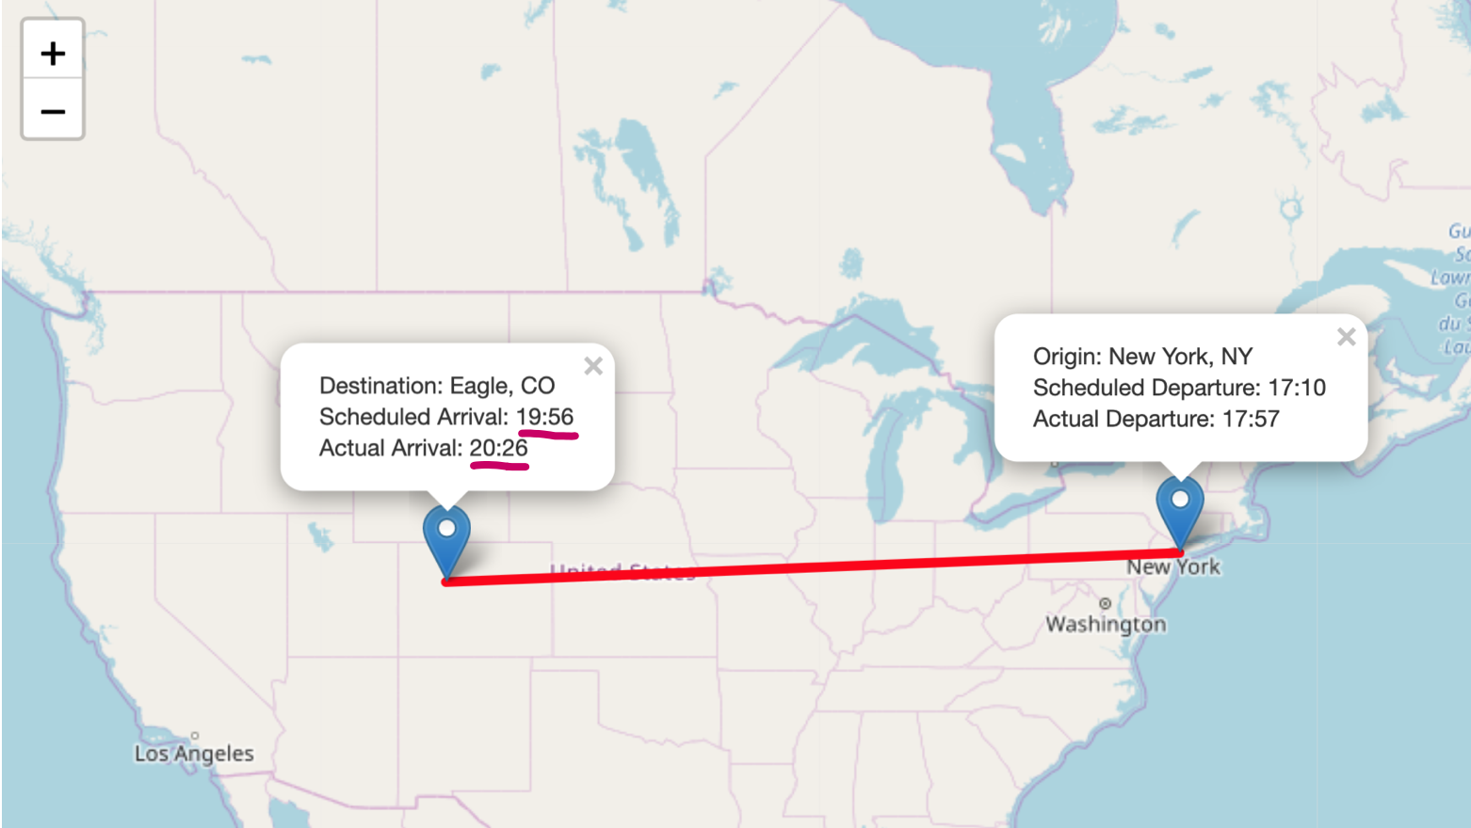
What Does a Delayed Flight Mean?
The Federal Aviation Administration considers a flight to be delayed when it is 15 minutes later than its scheduled time*
Delay is measured based on difference in arrival time.
This flight recorded as delayed for 30 min in the dataset.
* Flight cancellation and delay Wikipedia entry
Notes:
We will first look at both departure and arrival flights in each airport

Slide 7
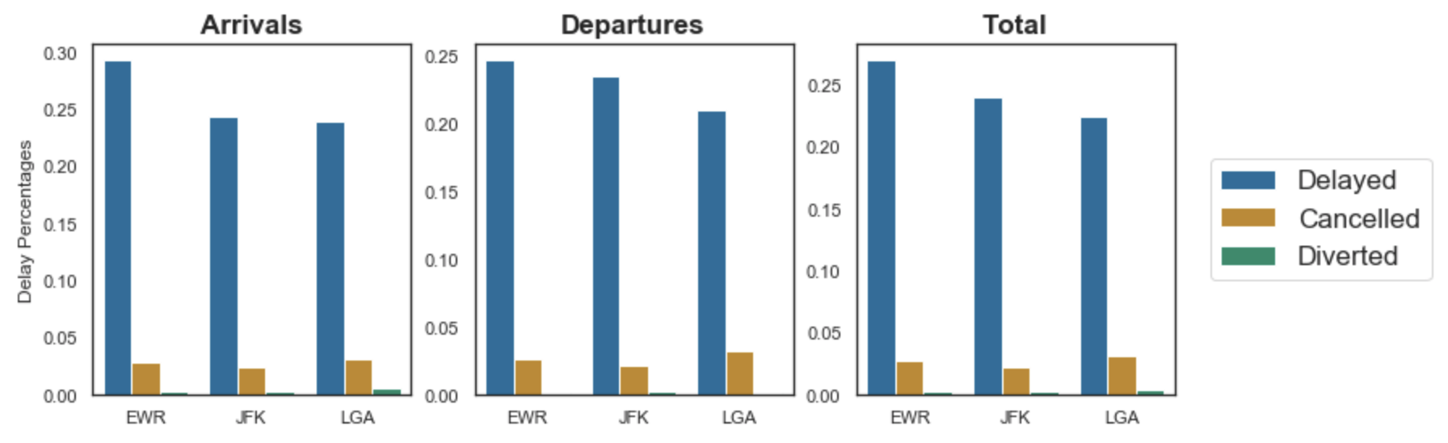
Delay Percentages in 3 Airports
Average delay time in total flights (min)
EWR: 73
JFK: 77.6
LGA: 75.6
Cancelled and diverted flights are ~ 3%
EWR has the highest delay percentage among 3 airports - 26.9% (total flights)
From now on we will look at delays at departure flights

Slide 8
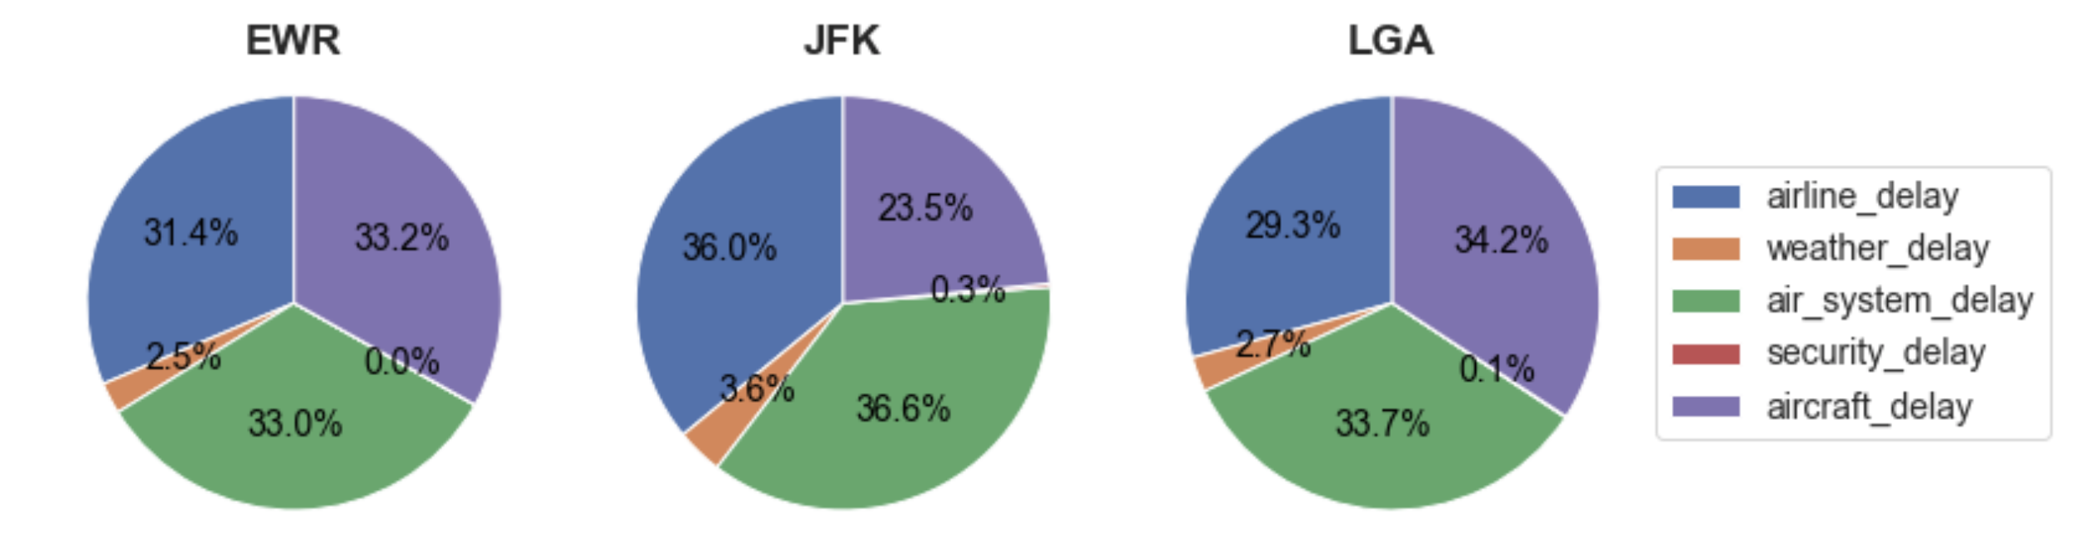
Delay Reasons
airline_delay: maintenance or crew problems, aircraft cleaning, baggage loading, fueling, etc.
weather_delay: extreme weather conditions such as tornado, blizzard or hurricane
air_system_delay: non-extreme weather conditions, airport operations, heavy traffic volume, and air traffic control
aircraft_delay: late-arriving craft
security_delay: evacuation of a terminal or concourse, re-boarding of aircraft because of security breach etc.
Notes:
Air Carrier: The cause of the cancellation or delay was due to circumstances within the airline's control (e.g. maintenance or crew problems, aircraft cleaning, baggage loading, fueling, etc.).
Extreme Weather: Significant meteorological conditions (actual or forecasted) that, in the judgment of the carrier, delays or prevents the operation of a flight such as tornado, blizzard or hurricane.
National Aviation System (NAS): Delays and cancellations attributable to the national aviation system that refer to a broad set of conditions, such as non-extreme weather conditions, airport operations, heavy traffic volume, and air traffic control.
Late-arriving aircraft: A previous flight with same aircraft arrived late, causing the present flight to depart late.
Security: Delays or cancellations caused by evacuation of a terminal or concourse, re-boarding of aircraft because of security breach, inoperative screening equipment and/or long lines in excess of 29 minutes at screening areas.

Slide 9
Delay Patterns in Time
Delay Percentage
Seasons
Months
Days in a Week
Time in a Day
Average Delay Time (if Delayed)
Seasons
Months
Days in a Week
Time in a Day
Mengya (Mia)
Notes:
Hypothesis testing is on the way

Slide 10
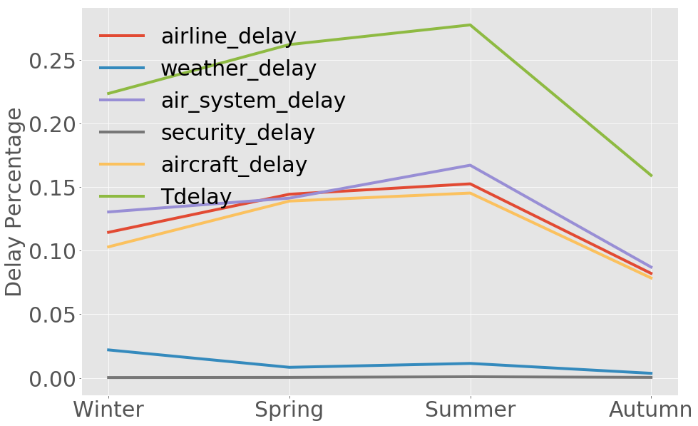
Delay Percentage: Seasons
Autumn is the best;
Spring & Summer is the worst.
Notes:
线加粗

Slide 11
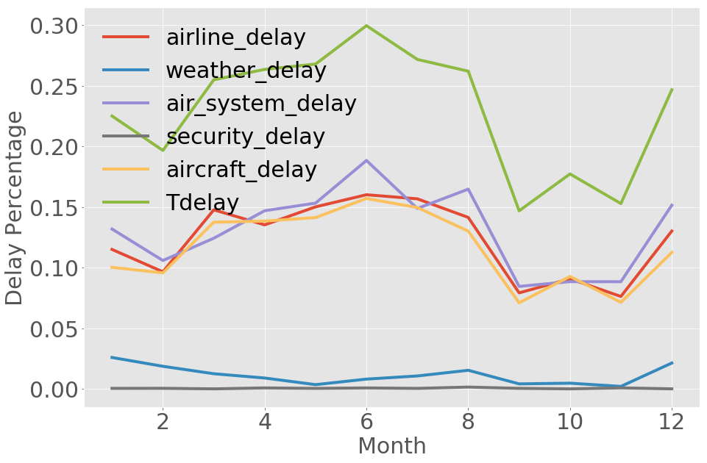
Delay Percentage: Months
Sept. to Nov. is the best;
April to July is the worst.

Slide 12
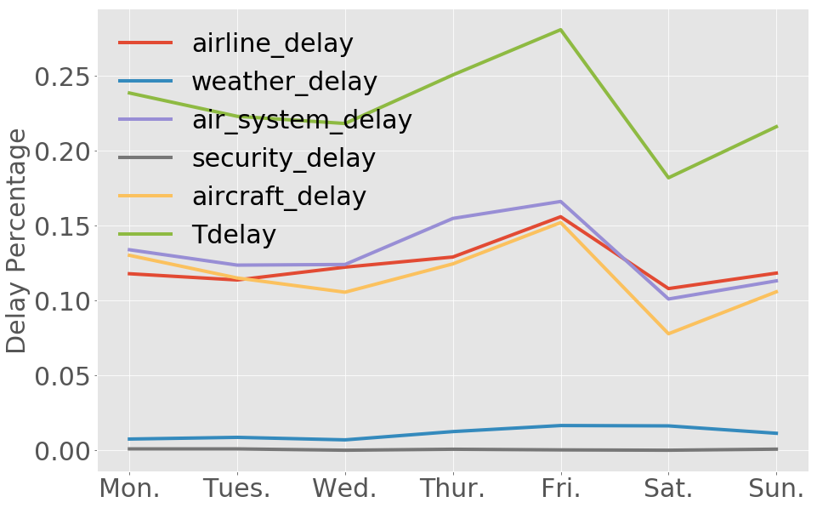
Delay Percentage: Days in a Week
Sat. is the best;
Fri. is the worst.

Slide 13
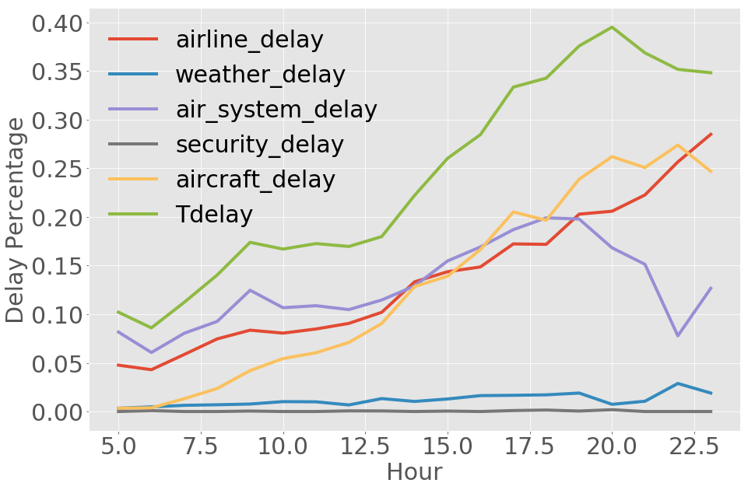
Delay Percentage: Time in a Day
Early in the morning is the best;
Around 8pm is the worst.

Slide 14
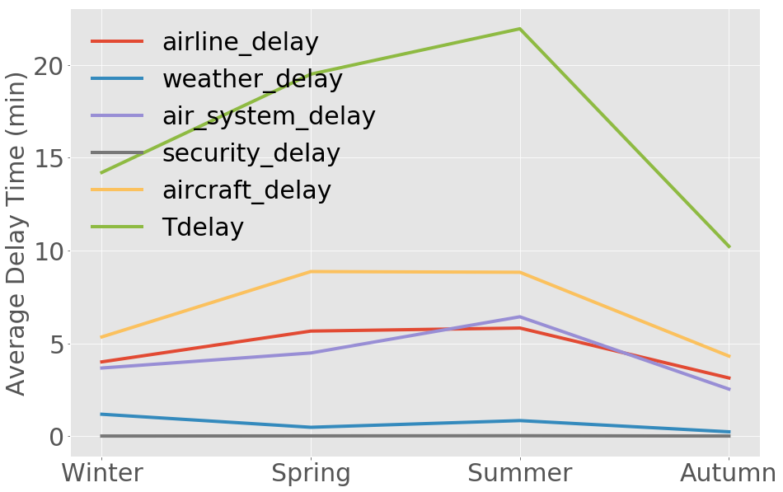
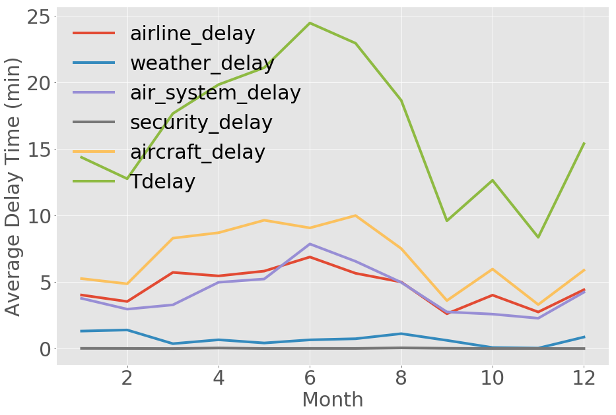
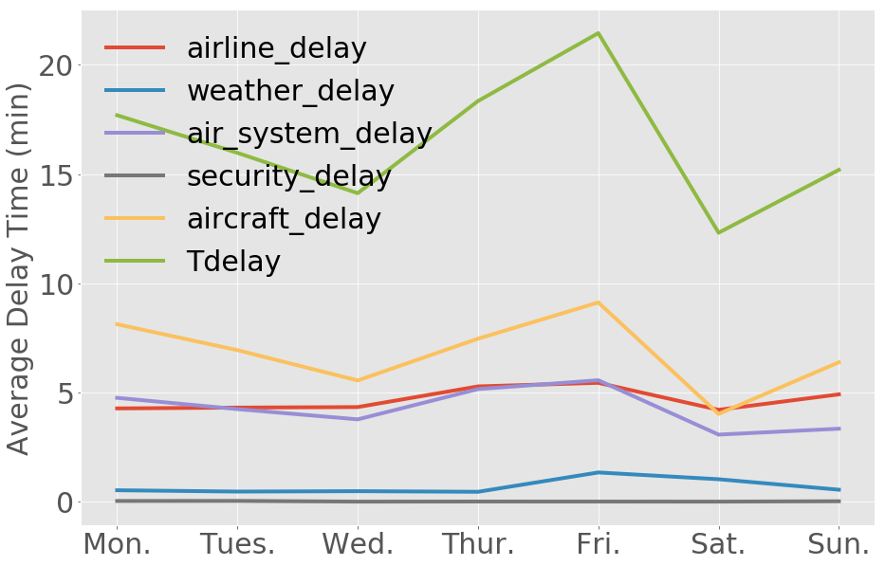
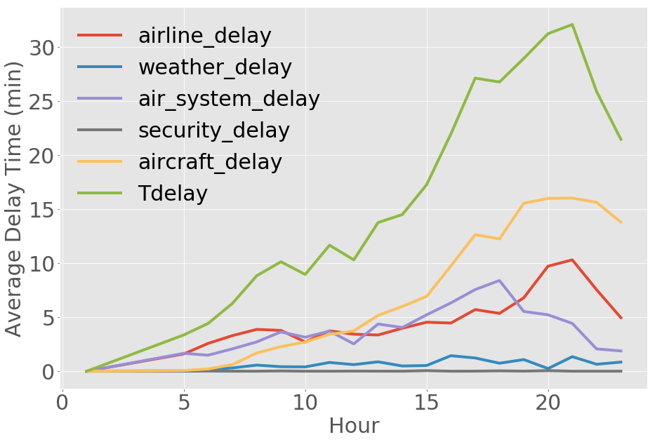
Average Delay Time (if Delayed)

Slide 15
Weather Condition Analysis
Which weather condition is the worst
Weather delays frequency per month
weather conditions per airport
Sonal

Slide 16
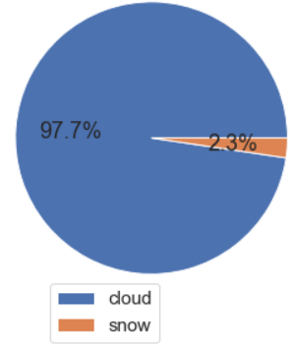
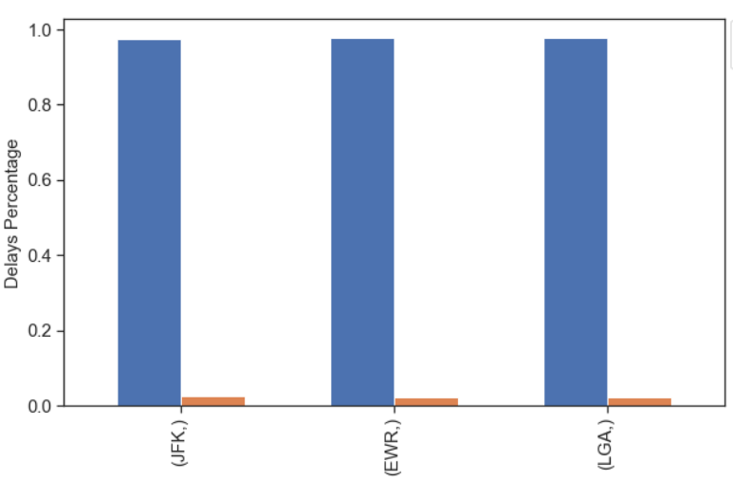
Weather Conditions Effect on Major NYC Airports
Dataset: Weather data collected at various US airports every 6 hours through 2017.
National Centers for Environmental Information
Cloudy weather condition affects the most
All three airports have the similar effect for cloudy and snow as they have same geographical region
Notes:
Weather data?
Weather data (temperature, wind, precipitation, cloud cover, etc.) collected at various US airports every 6 hours through 2017.
353,864 rows & 12 columns. Size: ~40MB. Source: National Centers for Environmental Information.
Weather data (temperature, wind, precipitation, cloud cover, etc.) collected at various US airports every 6 hours through 2017. 353,864 rows & 12 columns. Size: ~40MB. Source: National Centers for Environmental Information.

Slide 17
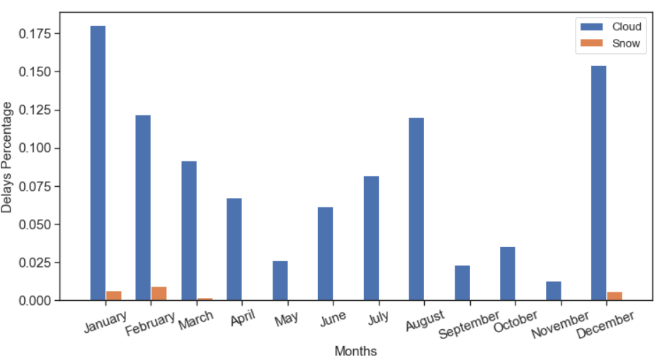
Weather Condition: Months
Mostly cloudy weather in winter and summer
Snow affects during winter only
Notes:
Number of weather delays due to snow/ number of all weather delays
Explain the reason for the results summer vs autumn

Slide 18
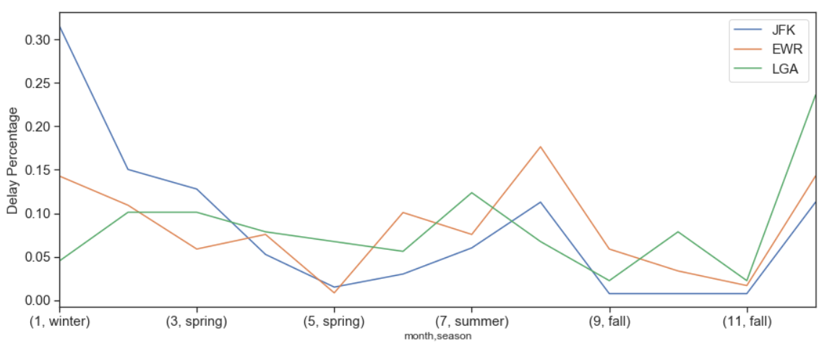
Weather Condition: Seasons
JFK is bad in winter. However, LGA has less delays percentage during extreme weather like winter
Notes:
LGA in winter why low?

Slide 19
Airline Analysis
Airline Rank
Airline Delay Analysis
Jianing

Slide 20
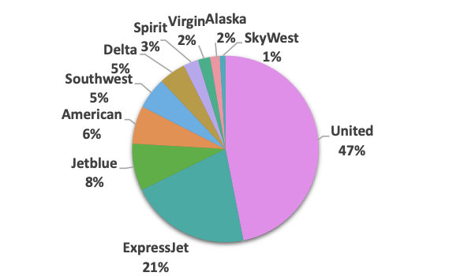
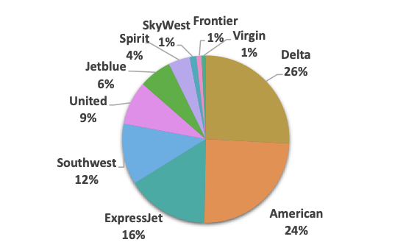
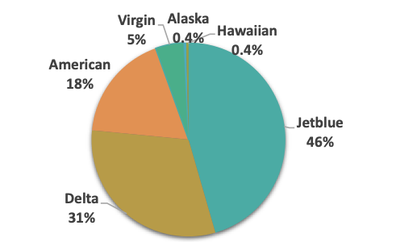
Airlines in NYC Airports
Airline Percentage for NYC Airports
JFK
EWR
LGA
Notes:
Except Frontier and Virgin in LGA, Alaska and Hawaiian in JFK. Other airlines all have more than 100 flights in each airport, which make the statistics meaningful.

Slide 21
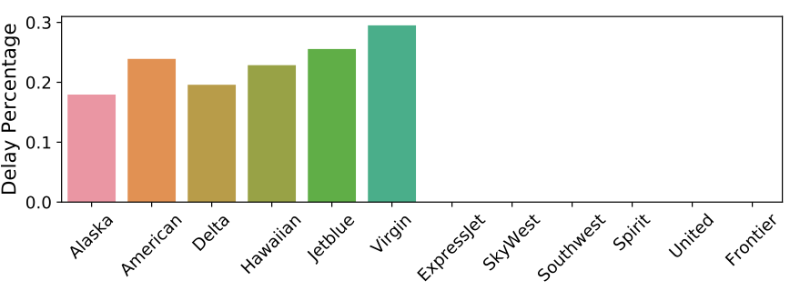
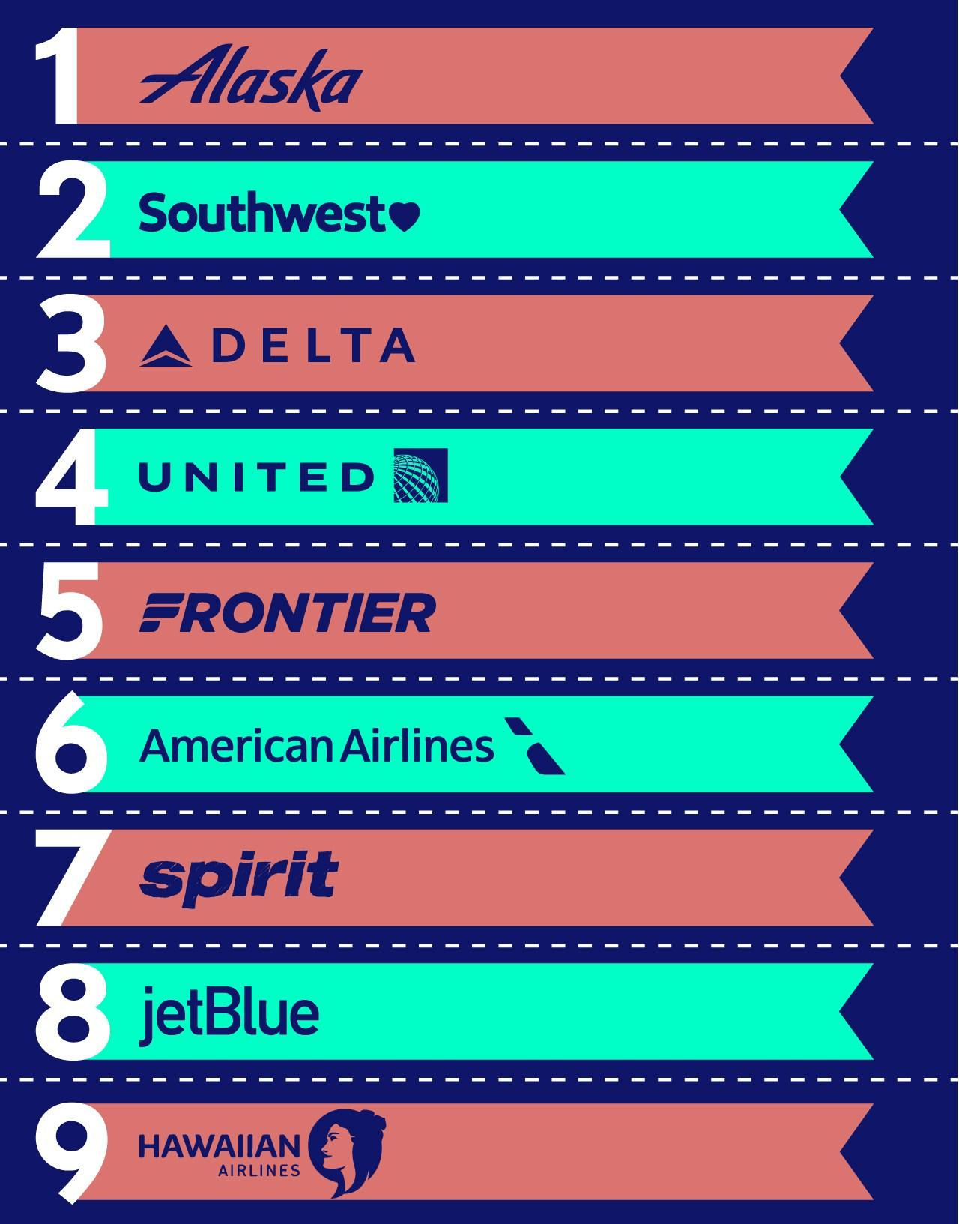
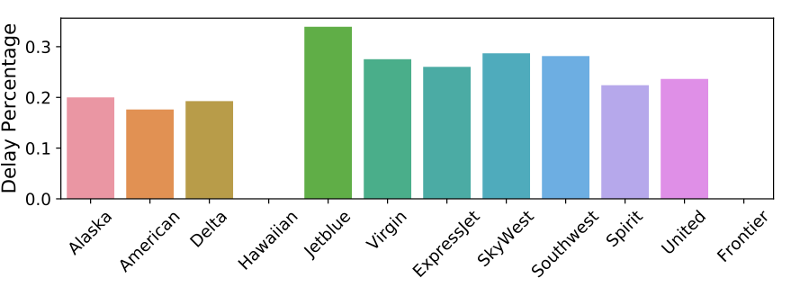
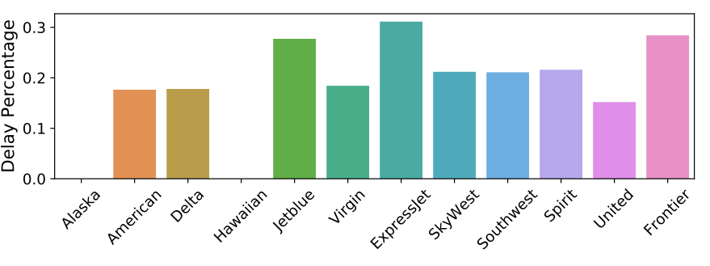
Airline Rank
Airline Rank in 2017
Airline Rank for NYC Airports
JFK
EWR
LGA
Rank of airline is from The Best and Worst US Airlines in 2018
Delta, American, United are the best airlines for JFK, EWR, LGA
Notes:
Pairwise-hypothesis analysis results:
JFK: Alaska has no difference with others, even with the worst one. Thus, we further check Delta, Delta has no difference with Alaska and Hawaiian, but it has less than 0.05 p value with others. So for JFK, the best one should be the Delta.
EWR: American has no difference with Delat, Spirit, Alaska(p-corr is 1). American has significant difference with SkyWest (p-corr: 0.6) and Virgin(p-corr: 0.08), but if using alpha=0.05, the significance is not enough. For others, the p-corr always less than 0.05.
LGA: United has no difference with SkyWest, Virgin, American, and Delta; it has significant difference with Southwest, Frontier and Spirit (less than 1 but larger than 0.05); for others, p-coor less than 0.05

Slide 22
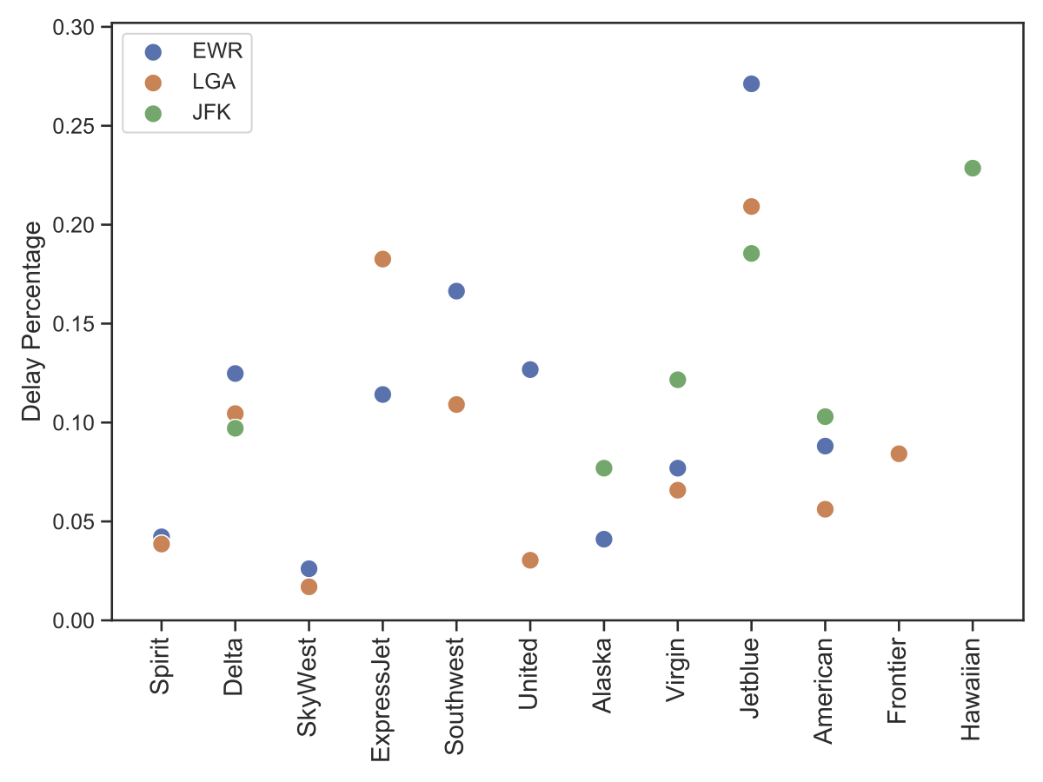
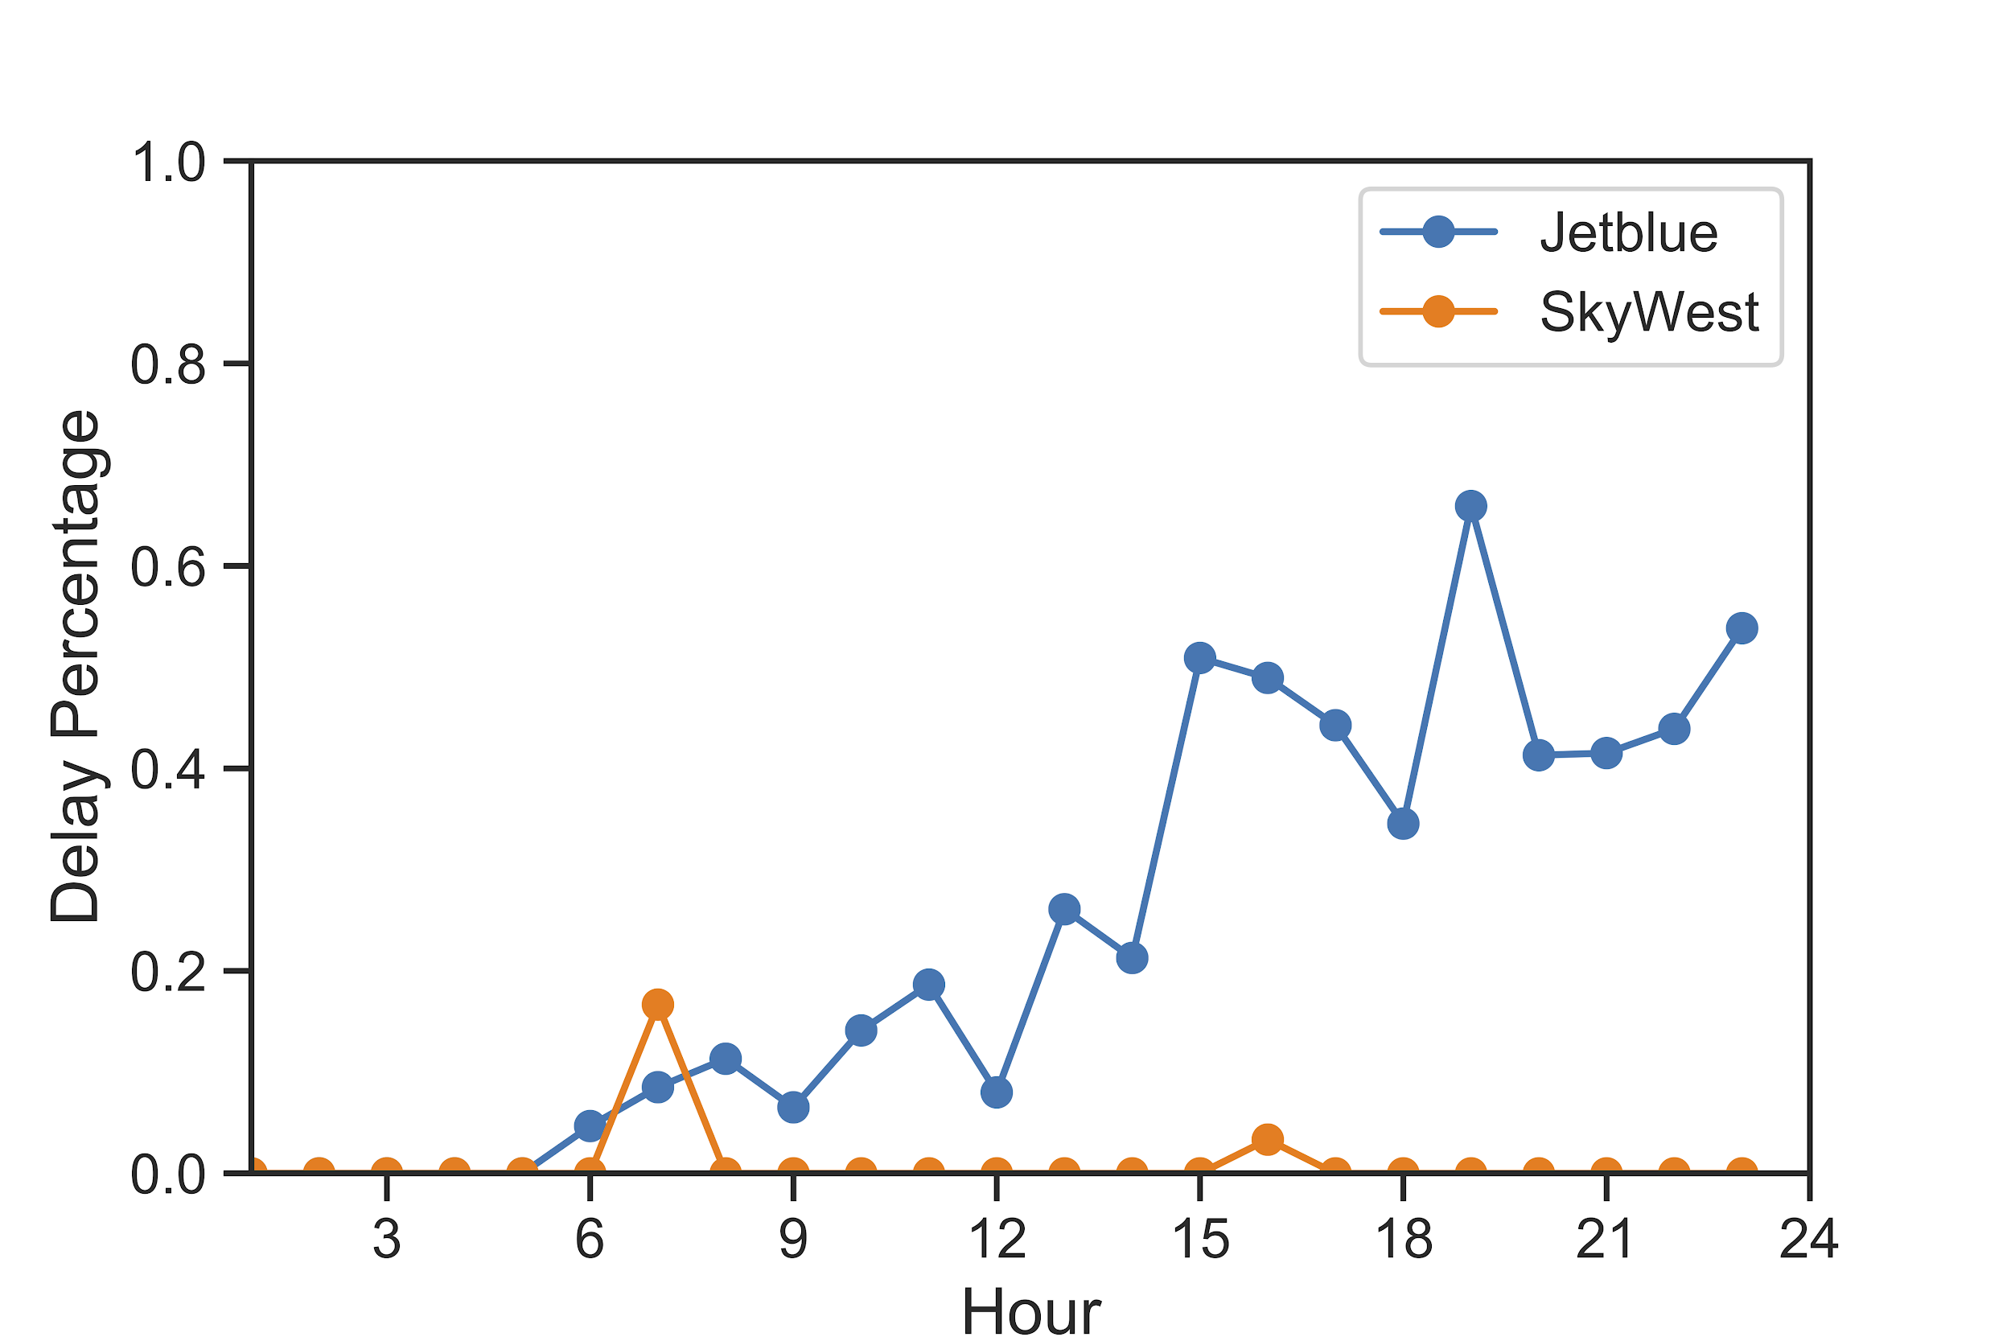
Airline Delay Analysis
Airline_Delay Percentage
Time?
Airline_delay: maintenance or crew problems, aircraft cleaning, baggage loading, fueling, etc.
Notes:
From five airlive delay types, actually, only two of them are related to airline (airline and aircraft) company. We compared different airline in different airport of airline related delay, which can really show different airline companies performance. However, can we directly used it to determine which airline we should take?
Actually, the airline related delay percentage depends on time. From morning to evening it always increase, but different airline have different performance.
Here, we draw the best airline delay performance using this coral line, and worst airline delay performance using the green line. It is clearly that from best to worst, the airline delay percentage can change a lot.
Mention the airline delay, and why we want to focus on that.
Pairwise Hypothesis Testing:
For Jetblue in JFK and SkyWest in LGA, the p is 1.4 * 10 ^-36, which validates their difference

Slide 23
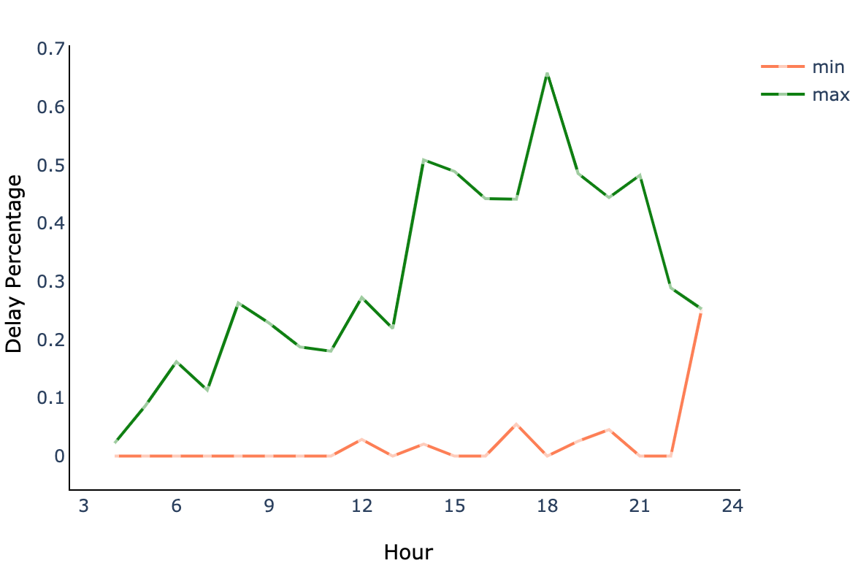
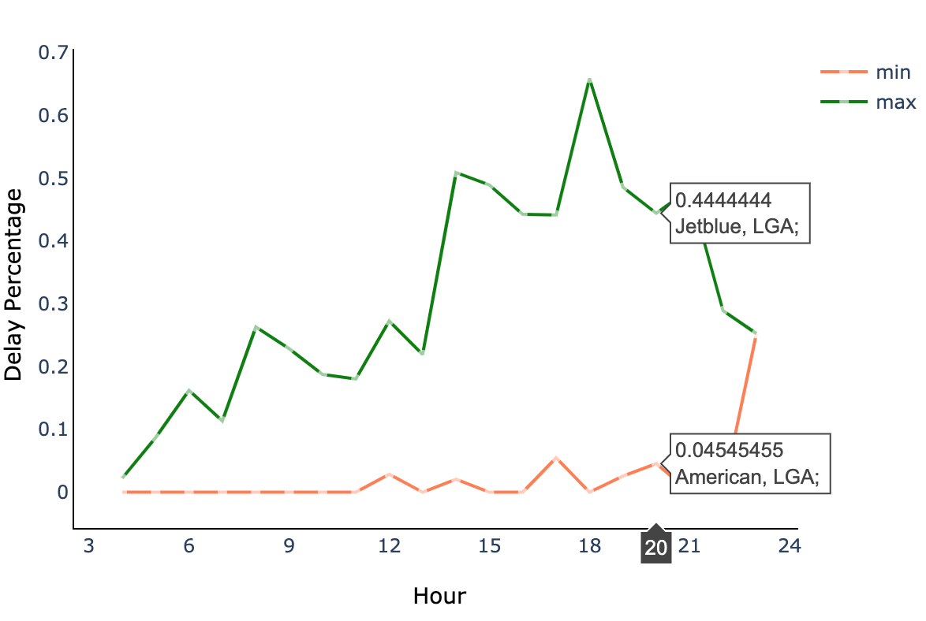
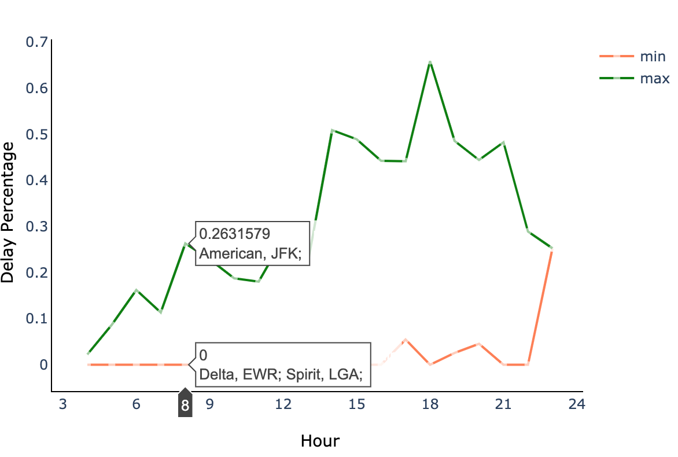
Best and Worst on Airline Delay : Time in a Day
Best / Worst airline ≠ always Best / Worst performance. Time is important.
Notes:
In 2017 at this time, at this airport. → We can see, airline choice should depend on not only the total delay percentage, but also need to consider the different time of a day. Generally recommendation, dip in more detailed.

Slide 24
Summary of Findings
Early in the morning, saturday and autumn are the best time to avoid delays. Late in the evening, friday and spring & summer are the worst.
LGA and EWR are the best airports to avoid delays due to extreme weather. JFK performs worst in extreme weather condition.
Generally, Delta, American, United are the best airlines for JFK, EWR, LGA, respectively. With consideration of time, you can further optimize your airline choice.

Slide 25
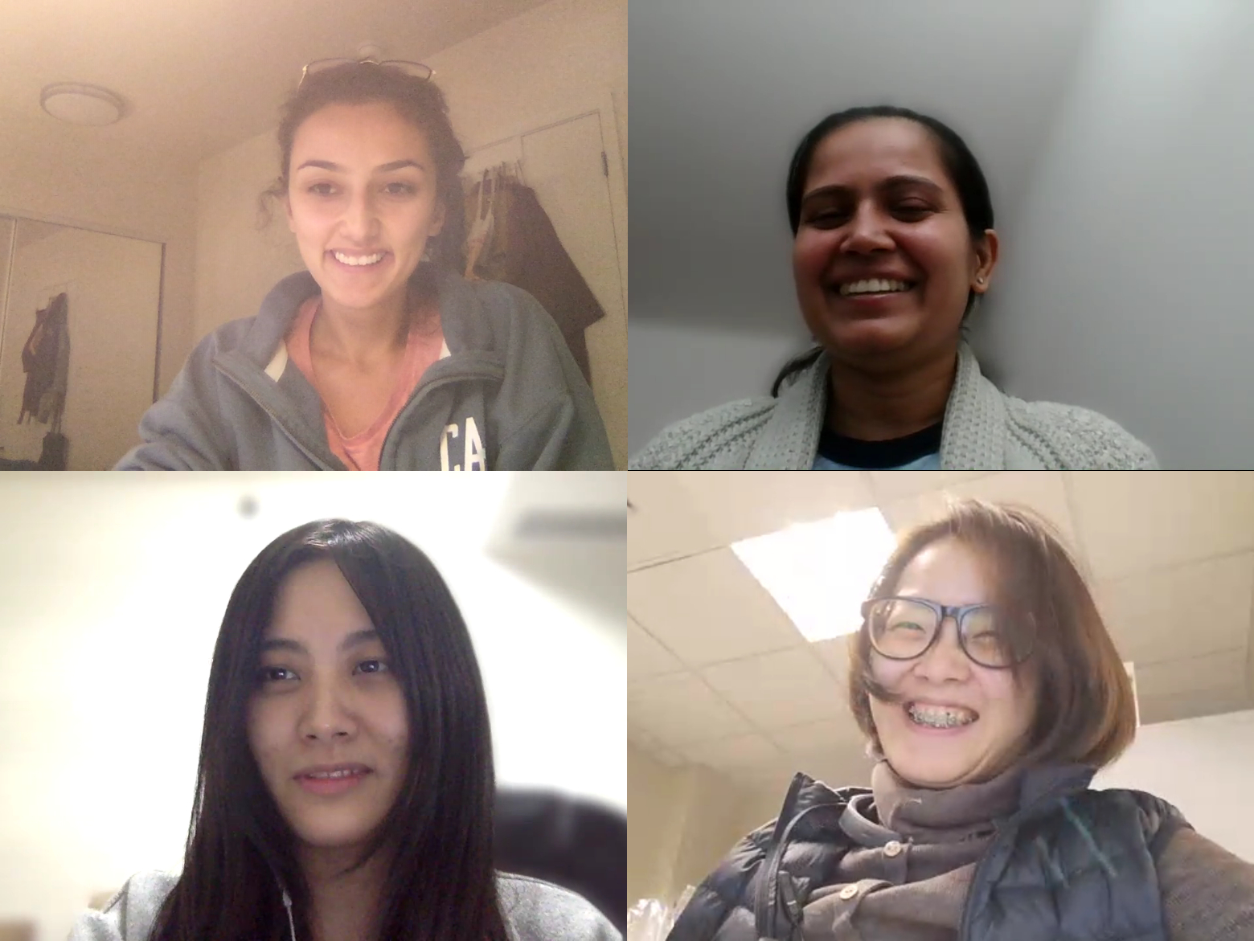
Thank You!

Slide 26
APPENDIX

Slide 27
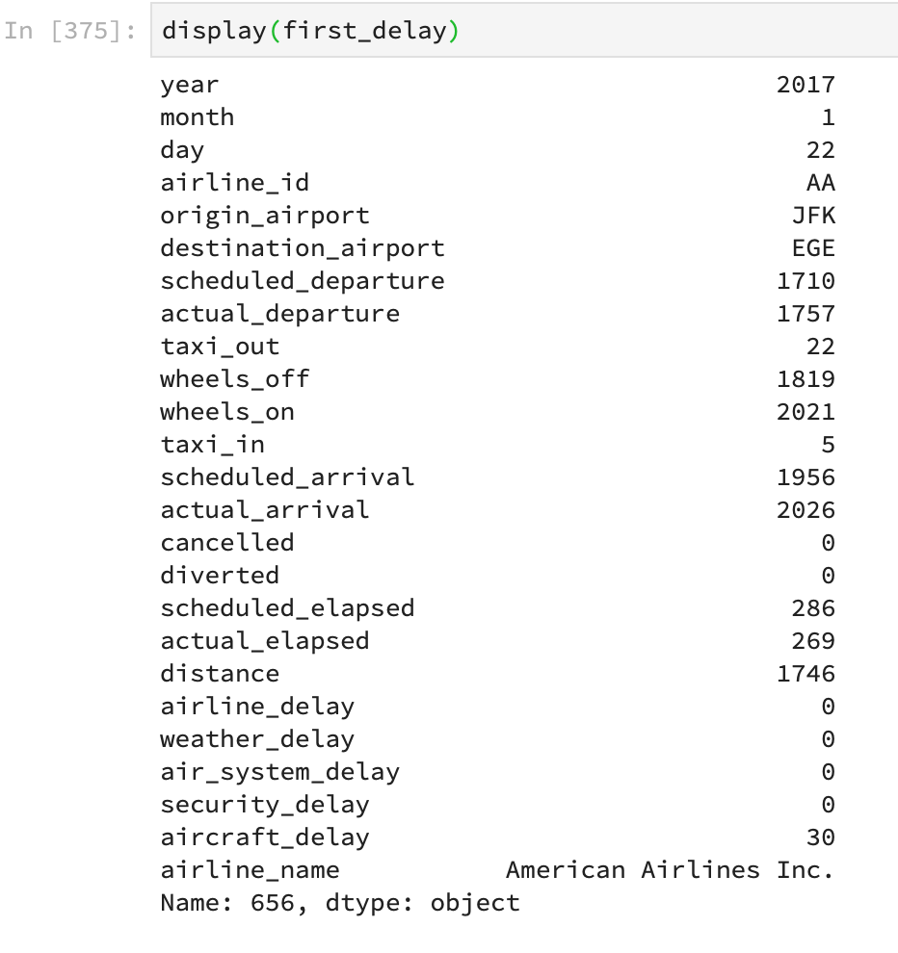
Delayed flight data in page 6

Slide 28
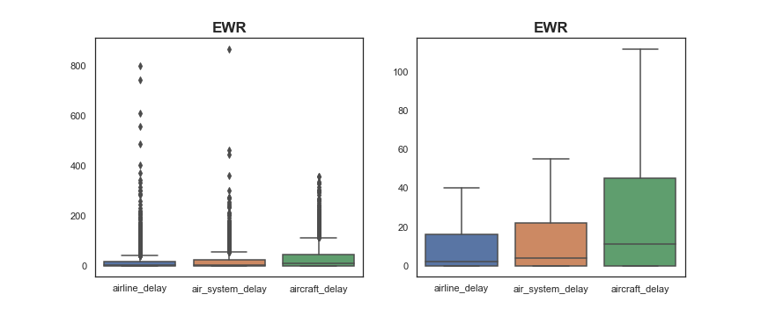
Delay time distribution

Slide 29

Delay time distribution

Slide 30
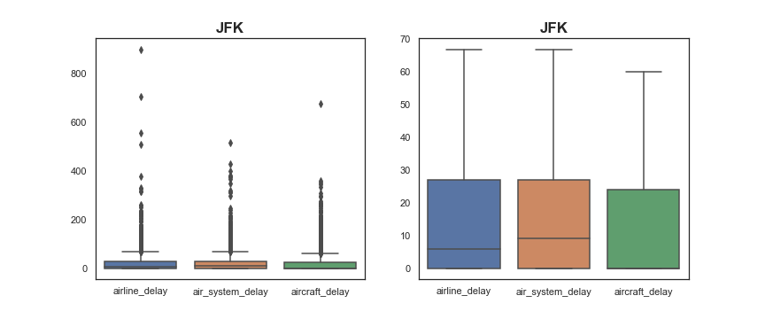
Delay time distribution

Slide 31
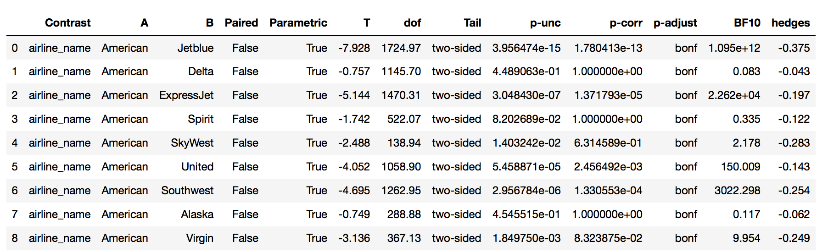
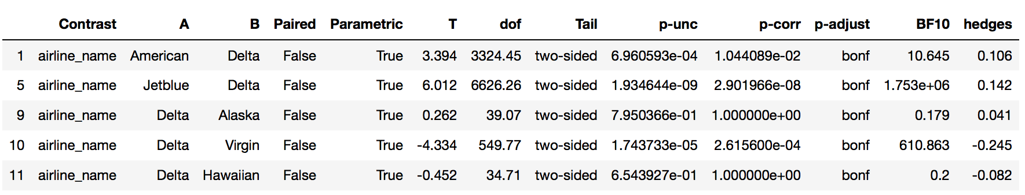
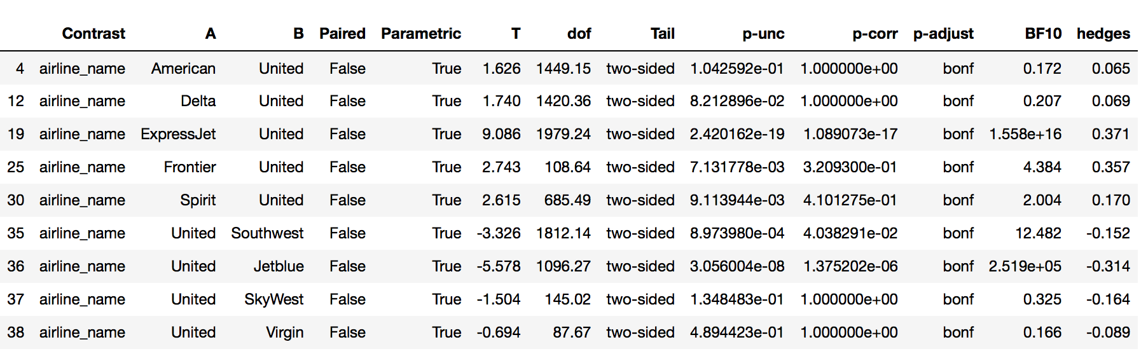
Hypothesis Testing for Airlines in NYC Airports
JFK:Delta
EWR: American
LGA:United
Best-worst for Airline_delay

Slide 32
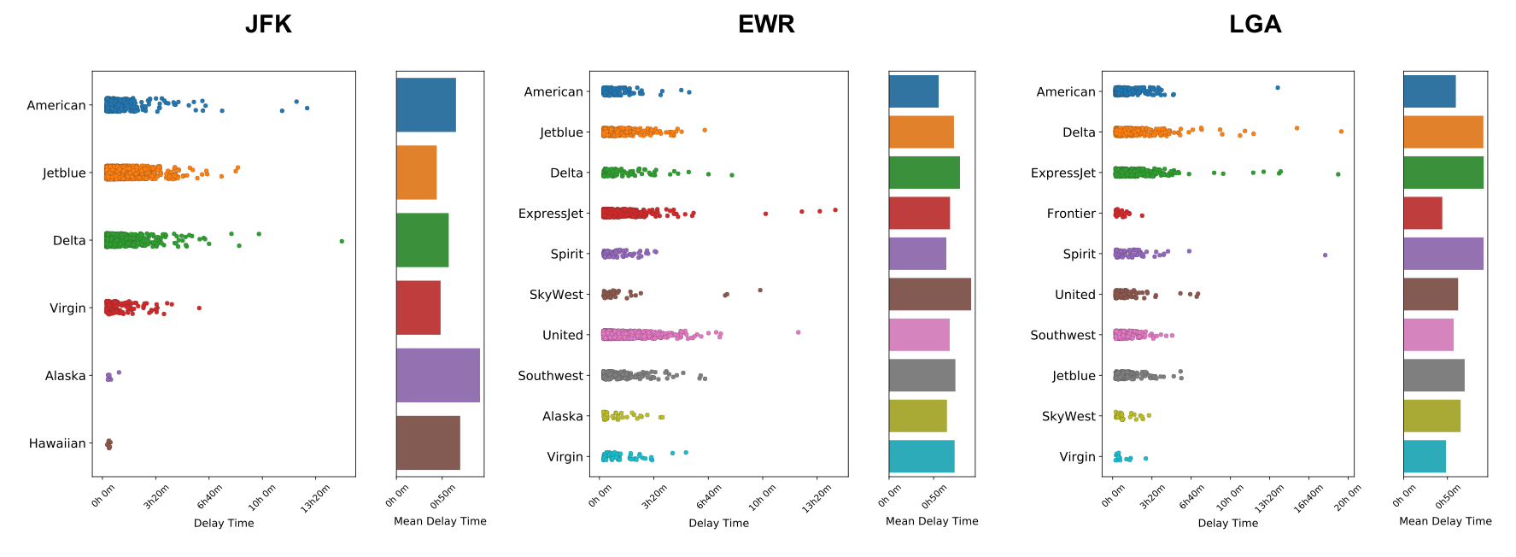
Delay Time for Different Airlines
Notes:
There are some outliers in delay time, but I didn’t find any resources can explain it. I also further looked at the delay type of airline_delay, the trend is slightly different from delay percentage, but I think it’s because of some extreme outliers that I don’t know how to explain.

Slide 33
Summary for Airline
Generally, Delta, American, United are the best airlines for JFK, EWR, LGA, respectively.
Considering the pure performance of airline companies, Jetblue is the worst and SkyWest is the best.
You can further choose specific airline for different time of a day using our analysis result to avoid high probability of airline_delay.
Notes:
This summary can be more concrete in final conclusion:

Slide 34
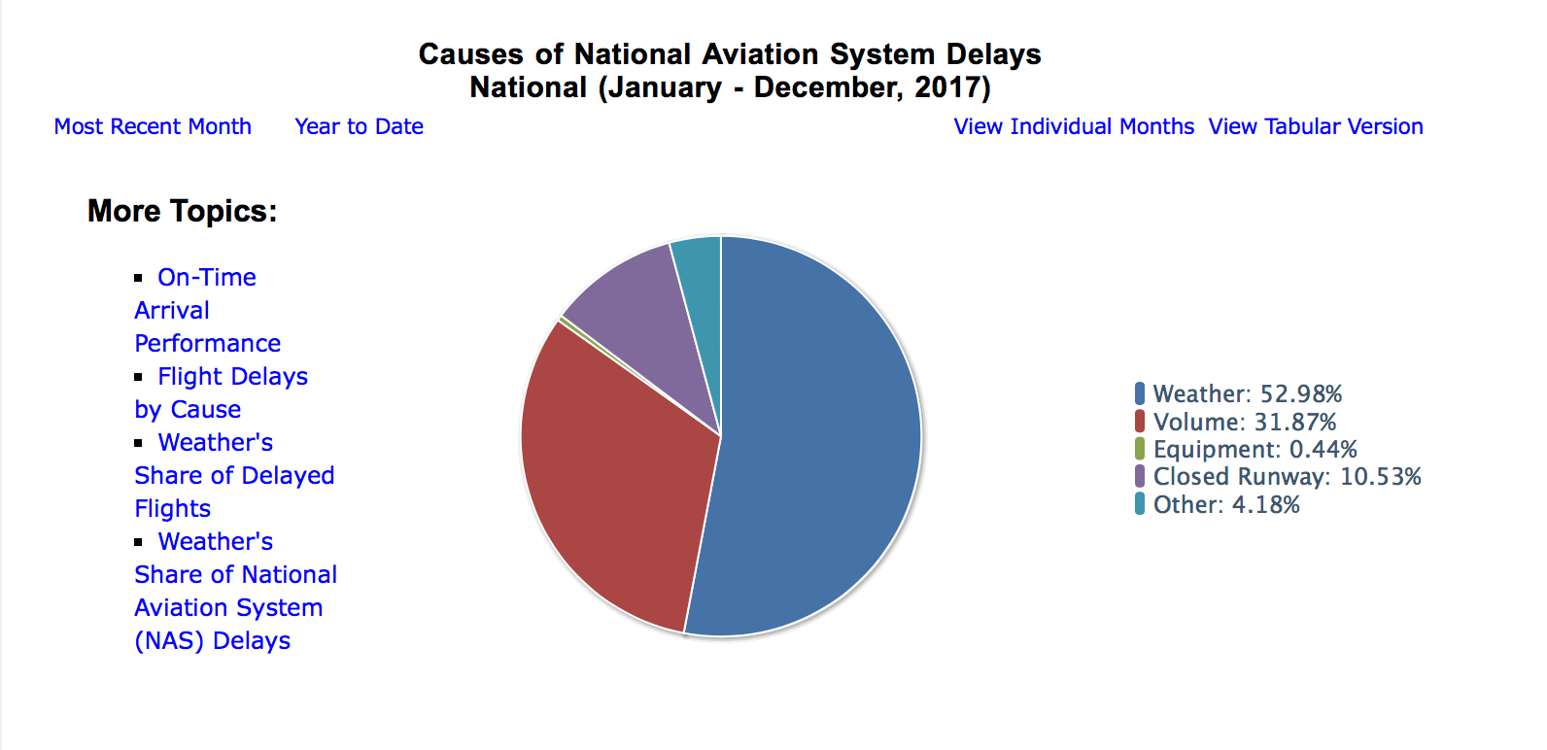
In air system delay, there is more than 50% are related to weather

Slide 35
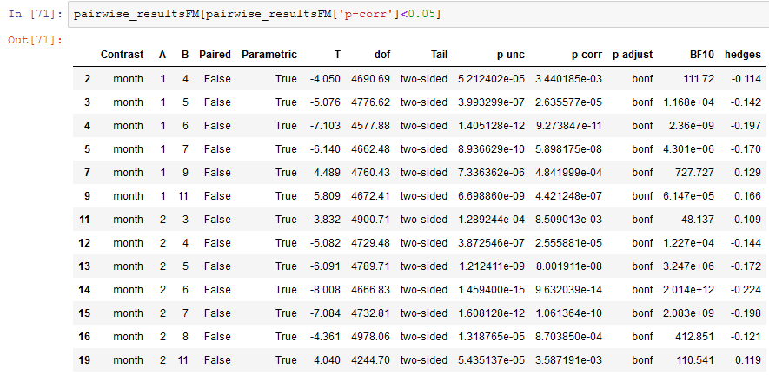
Hypothesis testing: Months

Slide 36
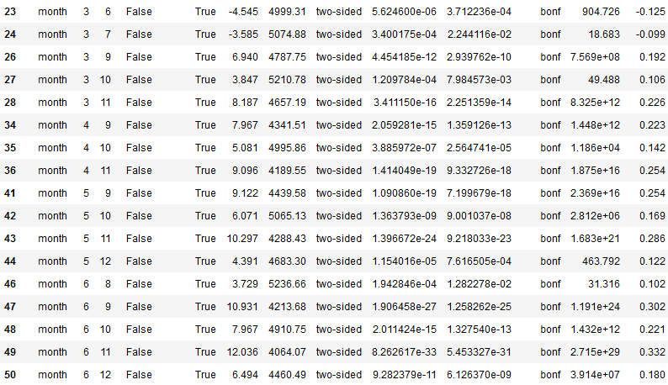
Hypothesis testing: Months

Slide 37
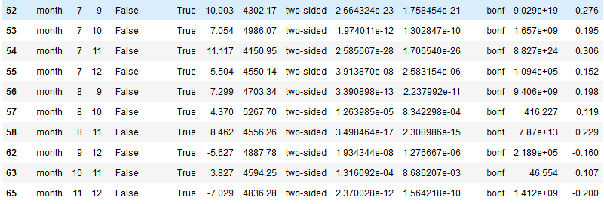
Hypothesis testing: Months

Slide 38
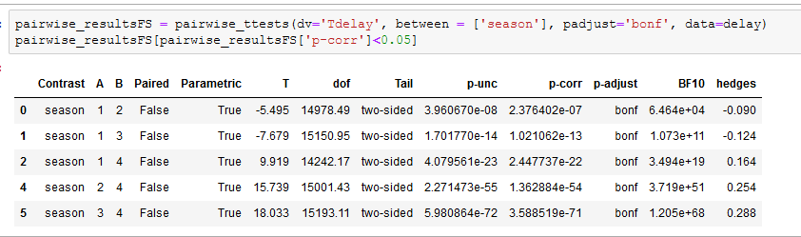
Hypothesis testing: Seasons

Slide 39
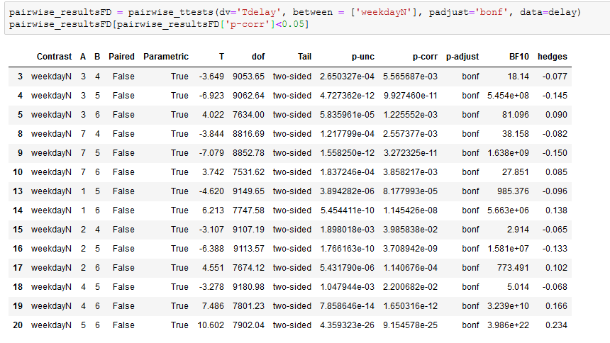
Hypothesis testing: Days

